Slide 1
Commuting and School Rank
INF1344 Final Project
Laura Cline, Ailin Z.W. Li, Lily Shaddick, Will Trefiak, Giselle Wenban
Notes:
Introduction - Lily
Data Visualizations Link: https://public.tableau.com/profile/laura.cline?fbclid=IwAR1dN4dYREg9VVD8-w3hhXGyxgvCJjTCfdhJ6fTrt8DN2aUbTLJ9TcBtYkQ#!/vizhome/StudentMoveTOCommutesAffectonSchoolChoice/Story1?publish=yes

Slide 2
Introduction
Notes:
First, we’ll discuss the background, research questions, and hypothesis

Slide 3
Background
Literature Review
Briggs (2006), Frenette (2004) and the NYC Urban Institute (2018) studied the factors that influence post-secondary school choice amongst students.
Greatest predictors were:
School reputation
Commute distance
Socio-economic status
Notes:
For our literature review, we conducted a survey of three works, which included studies by Briggs, Frenette and the NYC Urban Institute. These studies found that school reputation, commute distance and the socio-economic status of the students and/or their family were the variables that had the greatest impact on school choice. In addition, Frenette (2004) found that students from lower income families were disproportionately impacted by the effect of commute distance on school choice, while the NYC Urban institute (2018) found that students were more likely to choose a less reputable school in closer proximity, than a prestigious one that was outside of their borough.

Slide 4
Background
Goals of the Study
Based on the student commute research conducted in other countries, do the same patterns appear for students in the GTHA (Greater Toronto and Hamilton Area)?
Can we contribute additional insights to the 2019 study on student commuting conducted by the University of Toronto’s Transportation Research Institute (UTTRI) and the School of Cities?
Notes:
Ailin
This study has 2 main objectives:
The first is to see how well the research from other countries on student commute, which Lily just summarized, fits in the context of students in the Greater Toronto and Hamilton Area (or GTHA).
The second objective is to build upon the StudentMoveTO project published last year. This is the largest student commuter study ever undertaken in the GTHA; Giselle will talk more about this study and their open data set that we used later in the Methods section.

Slide 5
Research Question
Within the Greater Toronto and Hamilton Area (GTHA), is self-perceived impact of commuting on school choice associated with the rank of post-secondary institution (college and university) that students attend, controlling for network commute distance, age, gender, living situation, and annual family income?
Notes:
Giselle
We set out to explore whether there is a relationship between commute and school ranking. Our main research question is: Within the GTHA, is self-perceived impact of commuting on school choice associated with the rank of post-secondary institution (college and university) that students attend, controlling for network commute distance, age, gender, living situation, and annual family income?

Slide 6
Hypotheses
Null & Alternative Hypotheses
H₀: Students’ self-reported perception that their commute influenced their school choice is not associated with the overall ranking of the postsecondary institution these students attend.
H₁: A student’s self-reported perception that commute does impact school choice will be associated with attending a lower-ranked post-secondary school.
Notes:
Giselle
Next we will consider the research hypotheses. The null hypothesis is that Students’ self-reported perception that their commute influenced their school choice is not associated with the overall ranking of the postsecondary institution these students attend.
The alternative hypothesis is that A self-reported perception that commute does impact school choice will be associated with attending a lower-ranked post-secondary school.

Slide 7
Methods
Notes:
Now, we will provide an overview of our methods and the variables we selected.

Slide 8
Methods
Data Set
StudentMoveTO Data Set
A survey on student travel patterns and commutes from Fall 2019
Developed by the University of Toronto’s Transportation Research Institute (UTTRI) and the School of Cities
Data includes personal and household attributes, institution, transportation behaviours, perceptions of travel satisfaction, campus participation, academic success, and subjective well-being
Survey sample size of 10,631 represented within the dataset
Link to the StudentMoveTO dataset
Notes:
Giselle
For our research, we used the StudentMoveTO data set. The data set was created from a survey completed by students attending postsecondary institutions in the GTHA. Developed by the University of Toronto’s Transportation Research Institute and the School of Cities, the survey focused on student travel patterns and commutes in the Fall of 2019. The dataset covers a broad spectrum of information, including students’ personal and household attributes, the institution they attend, their transportation behaviors and their perceptions of travel satisfaction, campus participation, academic success and self-reported well-being.

Slide 9
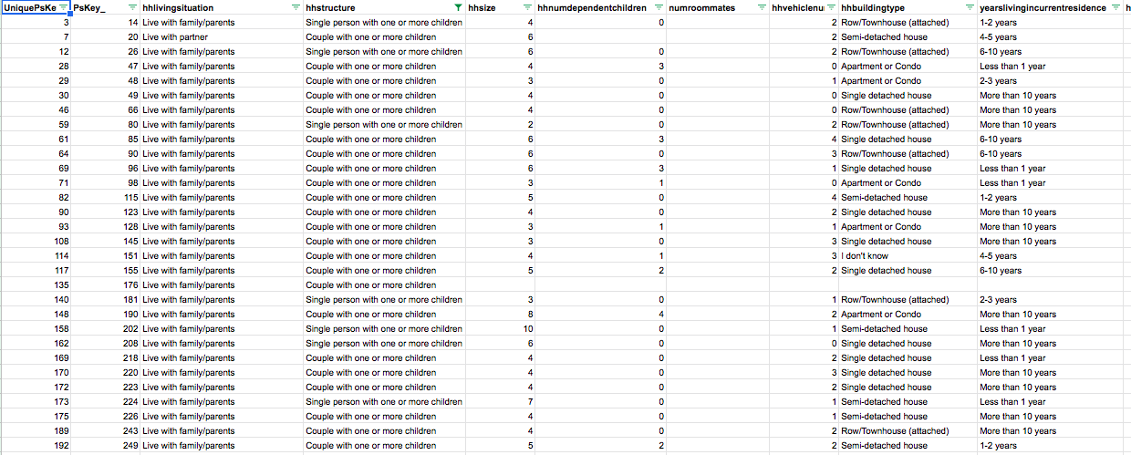
Methods
Data Set
Notes:
Giselle
Here is a snapshot of part of the dataset. The third column shows household living situation, which is one of our control variables that I will discuss in a moment.

Slide 10
Measurement
Dependent Variable
Dependent Variable | Description | Level of Measurement | College/University Rankings
Post-secondary school ranking (psinstitution) | 1 - 10 Colleges or Universities in GTHA | Ordinal Level assigned to each institution based on the Webometrics University Rankings | University of Toronto = 1 McMaster University = 2 York University = 3 Ryerson University = 4 Sheridan College Institute of Technology and Advanced Learning = 5 OCAD University = 6 Centennial College Toronto = 7 Mohawk College = 8 Ontario Tech University = 9 Durham College = 10
Notes:
First, the dependent variable we selected is the rank of the post-secondary school (college/university) students attend. For our research purposes, levels were assigned to each institution based on the Webometrics University Rankings, with higher ranking institutions receiving a lower magnitude.

Slide 11
Measurement
Independent Variable
Independent Variable | Description | Level of Measurement
Commute Influencing School Choice (ps05commuteFactorInSchoolChoice) | If self-reported commute time was a factor in school choice | Nominal No = 1, Yes = 2
Notes:
Giselle
The independent variable is commute influencing school choice, where students self-reported whether commute was a factor in their postsecondary school selection or not.

Slide 12
Measurement
Control Variables
Control Variable | Description | Level of Measurement
Network Commute Distance (networkCommuteDistance) | Distance between home and main campus (meters) using a street network | Interval
Gender (psgender) | Female (=1), Male (=2), Non-Binary / third gender (=3) | Categorical
Age (psage) | Interval scale 1 - 200 | Interval
Household Living Situation (hhlivingsituation) | 5 Living Situations: “Live with family/parents”; “Live with partner”; “Live alone”; “Live with roommates”; and “Live with host family or at a friend’s house” | Categorical
Family Income Level (familyincomelevel) | Annual family income 12 Income levels: From <$14,000 to >$200,000 | Categorical
Notes:
Giselle
We selected five control variables. Network commute distance refers to the distance in metres between a student’s home and their main campus when they take their typical street route.
The remaining control variables are student gender, age, their household living situation, and their annual family income level.
Now, Will is going to discuss the data analysis.

Slide 13
Analysis
Data Cleaning and Variable Transformation(s)
Combine the 3 MoveTO .csv files into a single dataframe [MTO] using merge()
Remove N/A, “I don’t know,” and “prefer not to answer” responses from [MTO]
Recode dependent variable [psinstitution] entries to match their rankings in the Webometrics Ranking of World Universities (2020) using revalue()
Set relevant categorical/nominal variables to factors using as.factor()
Reset the reference levels of two factored variables: hhlivingsituation.f and familyincomelevel.f using revalue()
Notes:
Thanks Giselle :) So, I’m going to give a brief overview of some technical aspects of our data analysis and the high level transformation process that was required prior to conducting an OLS regression using R. This can be broken down into five broad steps.
First, after uploading the MoveTO dataset as three separate CSVs into RStudio, they were merged into a single dataframe called ‘MTO’ to make the subsequent data transformations easier. This was done using the merge function.
Second, a series of transformation and cleaning operations were performed to filter NA, “I don’t know”, and “prefer not to answer” rows out of our selected variables. This process reduced our sample size from about 19000 to just over 5000 observations.
Third, the dependent variable psinstitution was recoded so the possible institution entries better corresponded with their respective ranking in the Webometrics Ranking of World Universities survey. As a result, U of T is at the top of this recoded list with a magnitude of 1, McMaster is second on this list with a magnitude of 2, Ryerson University is third with a magnitude of 3, and so on. This was done using the revalue function.
Fourth, the nominal and categorical data selected as independent and control variables were also set to a factor using the as.factor function.
Fifth, two of the variables set to factor also had to be further transformed to accommodate for incorrect reference levels. As a result, the reference levels of hhlivingsituation and familyincomelevel were changed using the relevel function.
After this data transformation, we were able to run a regression as seen here: [NEXT]

Slide 14
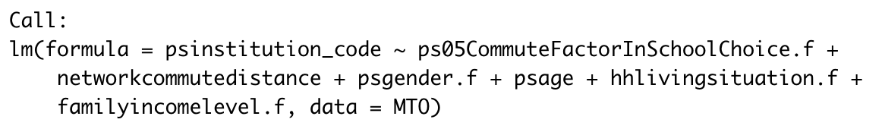
Linear Regression
Function Call
Variable transformations:
revalue()
as.factor()
as.factor() + revalue()
Notes:
Since our dependent variable is categorical, we chose to conduct a linear regression to determine potential correlations between our dependent variable seen here as psinstiution_code - a recoded version of psinsitution with the newly assigned magnitudes I just described;
And our independent variable, which is a factored version of ps05CommuteFactorInSchoolChoice.
In addition, our control variables are networkcommutedistance, a factored psgender, psage, hhlivingsituation factored with an adjusted reference level, and also familyincomelevel factored with an adjusted reference level.
With this in mind, Ill now pass it over Laura who will first provide some descriptive statistics of our dataset before Ailin discusses the output of this regression model.

Slide 15
Descriptive Statistics & Linear Regression Results
Notes:
LAURA

Slide 16
Descriptive Statistics: Dependent Variable
Other Interesting Variables
Variable | N | Descriptive Statistic
College/University Ranking | 5358 | Mode: #1
Variable | N | Descriptive Statistic
Name of Institution | 5358 | Mode: University of Toronto
College or University | 5358 | Mode: University

Slide 17
Descriptive Statistics
 | Variable | N | Descriptive Statistic
Independent Variable | Commute Factor in School Choice | 5358 | Mode: Yes
Control Variables | Network Commute Distance | 5358 | Mean: 17699.63 meters SD: 19991.44 meters
 | Gender | 5358 | Mode: Female
 | Age | 5358 | Mean: 21.5991 years SD: 5.362688 years
 | Living Situation | 5358 | Mode: Live with Family/Parents
 | Family Income Level | 5358 | Mode: $15,000 - $29,999

Slide 18
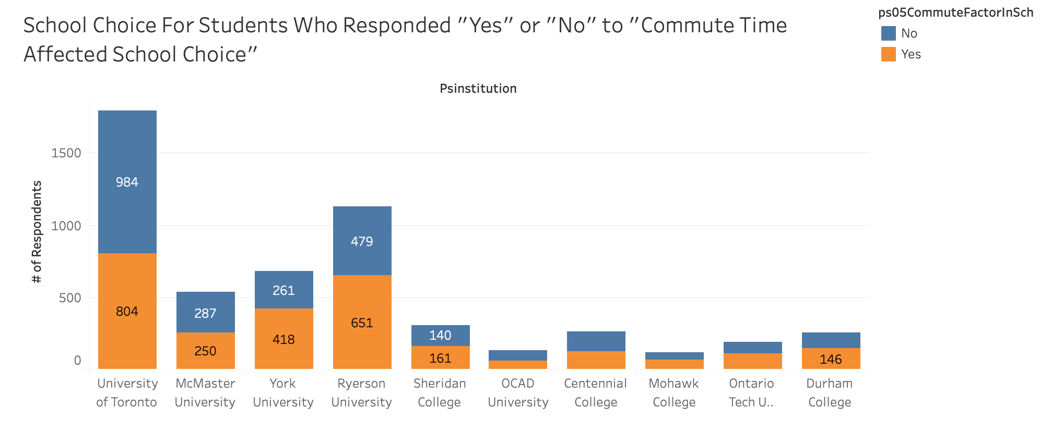
Data Exploration and Visualizations
Click here to explore the data -> Student Commute and School Choice Data Visualizations
Notes:
Now Ailin is going to discuss the regression results

Slide 19
Linear Regression Results
Discussion of Main Findings
Linear Regression Results for Main Variables
Model |  | B | Std. Error | t | Sig.
1 | (Intercept) | 2.939 | 0.196 | 15.017 | < 0.001 ***
 | Commute Influencing School Choice (“Yes”) | 0.307 | 0.074 | 4.122 | < 0.001 ***
 | Multiple R² | 0.06083
*** p < 0.001; ** p< 0.01; * p < 0.05
Notes:
Ailin
From our linear regression, we saw a number of parameters that are statistically significant. The R² value shows that about 6.08% of the variation in our dependent variable (school ranking) can be explained by our linear regression model.
An intercept of 2.939 means that at reference level -- in this case, for a young female who has a commute distance of 0m, whose commute did not influence school choice, and is living with her family who has an annual household income of $15,000-29,999 -- their school rank is 2.939, which is a relatively high-ranking school in our model, since lower ranked schools have a higher value.
The coefficient for our independent variable -- commute influencing school choice -- is also significant, such that the average school ranking for students whose commute influenced their school choice is 0.307 units higher than for students whose commute did not influence their school choice. In our model, this means a slight decrease in school ranking for students whose commutes influenced their school choice.

Slide 20
Linear Regression Results
Discussion of Control Variables
All of the control variables were also significant in our model:
Network commute distance
Age
Gender
Living situation
Annual household income
Notes:
Ailin
Almost all of our control variables were also statistically significant, so I’ll go through each of them in summary. Holding all other variables constant:
First, an increase in network commute distance was correlated with a decrease in school ranking. However, this result isn’t practically meaningful, as the result was 0.000004. This makes sense, though, since students were polled when they were already attending school, so they’ve already chosen the commuting arrangement that works best for them.
Second, older people are more likely to attend a lower-ranked post-secondary, with 1 unit of age correlated with a 5.029 unit increase on school ranking (which, in our case, is a lower-ranked post-secondary).
Third, men are more likely to attend a lower-ranked post-secondary, holding other variables constant.
Fourth, those who live with a host family/at a friend’s house are more likely to attend a lower-ranked post-secondary, while those living alone are more likely to attend a higher-ranked post-secondary.
And lastly, those whose family income is less than $14,999/year are more likely to attend a lower-ranked post-secondary, while those whose family income is above $30,000/year are more likely to attend a higher-ranked post-secondary, with the most significant results for families with an annual income above $80,000.
And to close things off, Lily will discuss our conclusion.

Slide 21
Conclusion

Slide 22
Conclusion
Summary of Results
Significant predicting variables with similar patterns:
Family income and perceived impact of commute distance
New insights for contribution to the study:
Age and gender; men and older individuals were more likely to attend a lower ranked institution
Conclusion is to reject the null hypothesis, but all control variables had significant effects.
Notes:
For conclusion, I will recap the goals of the study, which were:
Based on the student commute research conducted in other countries, do the same patterns appear for students in the GTHA (Greater Toronto and Hamilton Area)?
Can we contribute additional insights to the 2019 study on student commuting conducted by the University of Toronto’s Transportation Research Institute (UTTRI) and the School of Cities?
A summary of our results concludes that..
Significant predicting variables for choice of post-secondary institution point to family income, where students from lower income households are more likely to attend lower-ranked institutions, and perceived impact of commute distance on school choice has a measurable effect on the rank of post-secondary institutions students attend. This indicates that a similar pattern exists between the students of the GTHA and the existing studies detailed in the literature of Briggs, Frenette and the NYC Urban Institute
New insights for contribution to the StudentMoveTO study include Age and gender control variables; men and older individuals are more likely to attend a lower ranked institution
In conclusion, we reject the null hypothesis, which was “Students’ self-reported perception that their commute influenced their school choice is not associated with the overall ranking of the postsecondary institution these students attend”
However, we will note again that all control variables had significant effects in our study
Based on these results, in the future, policies could be put in place to assist students experiencing barriers due to commuting, which we will be discussed further in our final report.

Slide 23
Thank you!

Slide 24
References
Briggs, Senga (2006. An exploratory study of the factors influencing undergraduate student choice: the case of higher education in Scotland. Studies in Higher Education, Vol. 31,
No. 6, December 2006, pp. 705–722. Retrieved October 28, 2020, from https://journals-scholarsportal-info.myaccess.library.utoronto.ca/pdf/03075079/v31i0006/705_aesotfcoheis.xml.
Corcoran, S. P. (2018). School Choice and Commuting: How Far New York City Students Travel to School. NYC Urban Institute, 1-58. Retrieved October 28, 2020, from https://www.urban.org/sites/default/files/publication/99205/school_choice_and_commuting_3.pdf.
Frenette, Marc (2004). Access to College and University: Does Distance to School Matter?.
Canadian Public Policy / Analyse de Politiques, Vol. 30, No. 4 (Dec., 2004), 427-443.
Retrieved October 28, 2020, from
https://www-jstor-org.myaccess.library.utoronto.ca/stable/3552523
Mitra, R., Habib, K. N., Siemiatycki, M., Keil, R., Bowes, J., Taylor, R., . . . Siu, B. L. (2020). From Insight to Action on Transportation for Post-Secondary Students in the GTHA: 2019 Transportation Survey Findings. StudentMoveTo, 1-7. Retrieved October 28, 2020, from http://www.studentmoveto.ca/wp-content/uploads/2020/10/StudentMoveTO-2019-Report-Final-5-Updated-October-15-2020.pdf.
Webometrics Ranking of World Universities. (2020). Canada. Retrieved from https://www.webometrics.info/en/North_america/Canada.

Slide 25
Regression Results Summary
Residuals | Result
Min | -5.3589
1Q | -1.9946
Median | -0.4907
3Q | 1.0049
Max | 8.1426

Slide 26
Regression Results Summary
Significance Codes: 0 ‘***’ 0.01 ‘**’ 0.01 ‘*’ 0.05 ‘.’ 0.1 ‘ ‘ 1
 |  | Unstandardized Coefficients
Model |  | B | Standard Error | t | Significance
1 | (Constant) | 2.939e+00 | 1.957e-01 | 15.017 | < 2 e-16 ***
 | Commute Factor in School Choice.f Yes | 3.067e-01 | 7.440e-02 | 4.122 | 3.81e-05 ***
 | Network Commute Distance | 3.858e-06 | 1.911e-06 | 2.019 | 0.043549 *
 | Gender.f Male | 3.095e-01 | 7.391e-02 | 4.188 | 2.86e-05 ***
 | Gender.f Binary/Third Gender | 6.121e-01 | 3.018e-01 | 2.028 | 0.042576 *
 | Age | 3.489e-02 | 6.938e-03 | 5.029 | 5.08e-07 ***
 | Living Situation.f Live Alone | -8.062e-01 | 1.474e-01 | -5.469 | 4.73e-08 ***
 | Living Situation.f Live With Host Family or at Friend’s House | 1.182e+00 | 2.650e-01 | 4.461 | 8.31e-06 ***
 | Living Situation.f Live With Partner | -1.172e-01 | 1.598e-01 | -0.734 | 0.463198
 | Living Situation.f Live With Roommates | -1.511e-01 | 9.555e-02 | -1.581 | 0.113832
Notes:
Can’t find beta?

Slide 27
 |  | Unstandardized Coefficients |  | Standardized Coefficients
Model |  | B | Standard Error | Beta | t | Significance
1 | Familyincomelevel.f Less than $14,999 | 5.778e-01 | 1.562e-01 |  | 3.700 | 0.000218 ***
 | Familyincomelevel.f $30,000 - $39,000 | -7.430e-02 | 1.586e-01 |  | -0.468 | 0.639525
 | Familyincomelevel.f $40,000 - $49,999 | -4.585e-01 | 1.571e-01 |  | -2.918 | 0.003535 **
 | Familyincomelevel.f $50,000 - $59,999 | -7.295e-01 | 1.536e-01 |  | -4.749 | 2.10e-06 ***
 | Familyincomelevel.f $60,000 - $69,999 | -5.034e-01 | 1.598e-01 |  | -3.151 | 0.001636 **
 | Familyincomelevel.f $70,000 - $79,999 | 5.268e-01 | 1.716e-01 |  | -3.070 | 0.002153 **
 | Familyincomelevel.f $80,000 - $89,999 | -6.688e-01 | 1.740e-01 |  | -3.844 | 0.000123 ***
 | Familyincomelevel.f $90,000 - $99,999 | -9.180e-01 | 1.740e-01 |  | -5.205 | 2.01e-07 ***
 | Familyincomelevel.f $100,000 - $124,999 | -7.158e-01 | 1.473e-01 |  | -4.861 | 1.20e-06 ***
 | Familyincomelevel.f $125,000 - $149,999 | -8.556e-01 | 1.781e-01 |  | -4.804 | 1.60e-06 ***
 | Familyincomelevel.f $150,000 - !99,999 | -1.027e+00 | 1.776e-01 |  | -5.784 | 7.73e-09 ***
 | Familyincomelevel.f $200,000 + | -1.271e+00 | 1.752e-01 |  | -7.252 | 4.68e-13 ***

Slide 28
Regression Results Summary
Residual Standard Error | 2.514 on 5336 degrees of freedom
Multiple R Squared | 0.06083
Adjusted R Squared | 0.05713
F-Statistic | 16.46 on 21 and 5336 degrees of freedom
p-value | < 2.2e-16

Slide 29
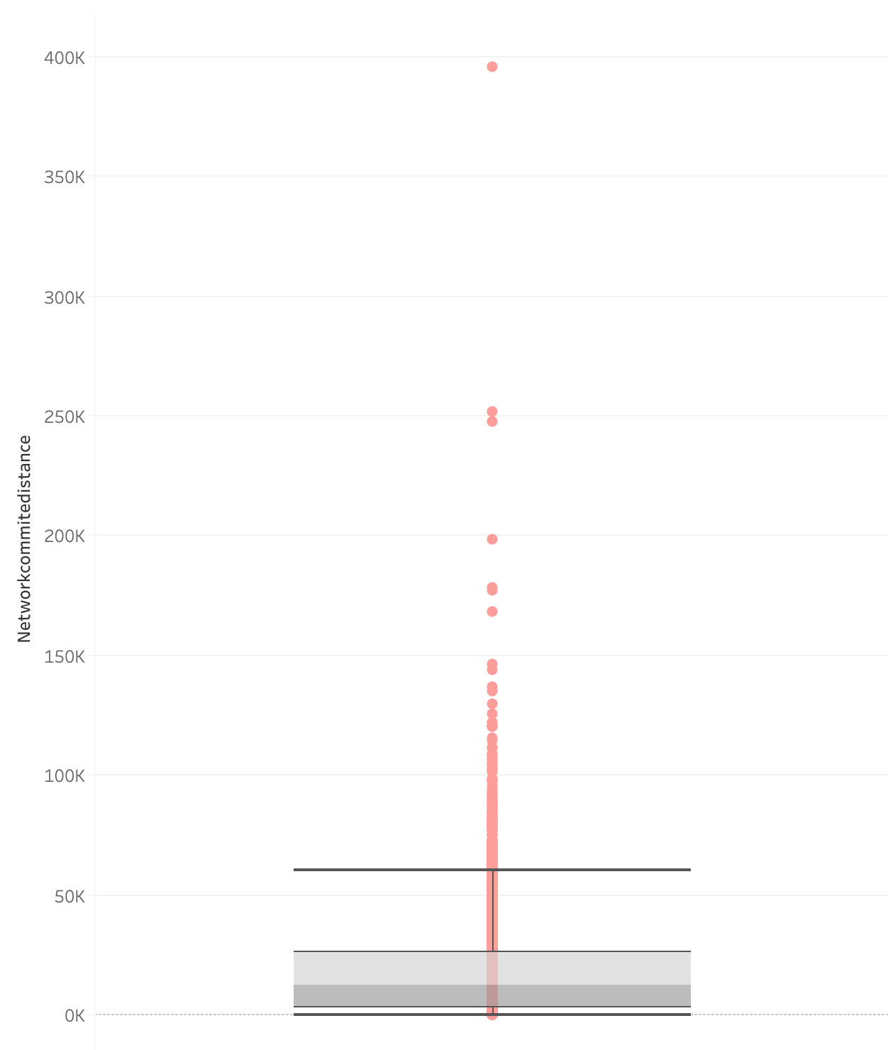
Boxplot for Network Commute Distance
The boxplot for the independent variable, Network Commute Distance, is positively skewed
The boxplot shows that the lower quartile is 2,932 meters and the upper quartile is 25,878 meters.
The boxplot has a minimum (Q1 - 1.5*IQR) of 1 meter
The boxplot has a maximum (Q3 + 1.5*IQR) of 60,167 meters.
The median is 12,383 meters.
Interact with the Boxplot here -> Boxplot for Network Commute Distance

Slide 30
Bivariate Correlation (R-Squared)
The four control variables - Gender, Age, Living Situation and Family Income Level - are also not highly correlated with the independent variable Network Commute Distance because all their Multiple R-Squared scores are < 0.60
IV -> | Commute Factor in School Choice | Gender | Age | Living Situation | Family Income Level
Network Commute Distance | 0.0088 | 0.0008 | 0.0052 | 0.1796 | 0.0078

